Slide 1

GitHub basics for newcomers
Tutorial and live demo
July 2023

Slide 2
Agenda for Today
Concepts
Practice
Have your GitHub account open and ready to practice with me!
Reference Materials
Disclaimer: this live demonstration about Git and one of many tools for working with Git, GitHub, is being recorded for training purposes. It is not an endorsement of GitHub.

Slide 3
Git
The problem
Ever dealt with multiple copies of a document floating around, such as when combining edits from multiple people?
You end up with "draft with fred comments" and "final" and "final final for release" versions of the same text. It’s hard to manage!
Version control
Multiple edits from multiple parties can be tracked in one place
Ability to "jump" back in time (finding bugs, for example)
Git is a tool that allows developers and others to use version control

Slide 4
GitHub
Web interface for Git, used by many government agencies
Multiple edits from multiple parties can be tracked in one place
Platform for the rest of the concepts today
Allows you to see changes tracked by Git on the web, like the typo fix on the following slides

Slide 5
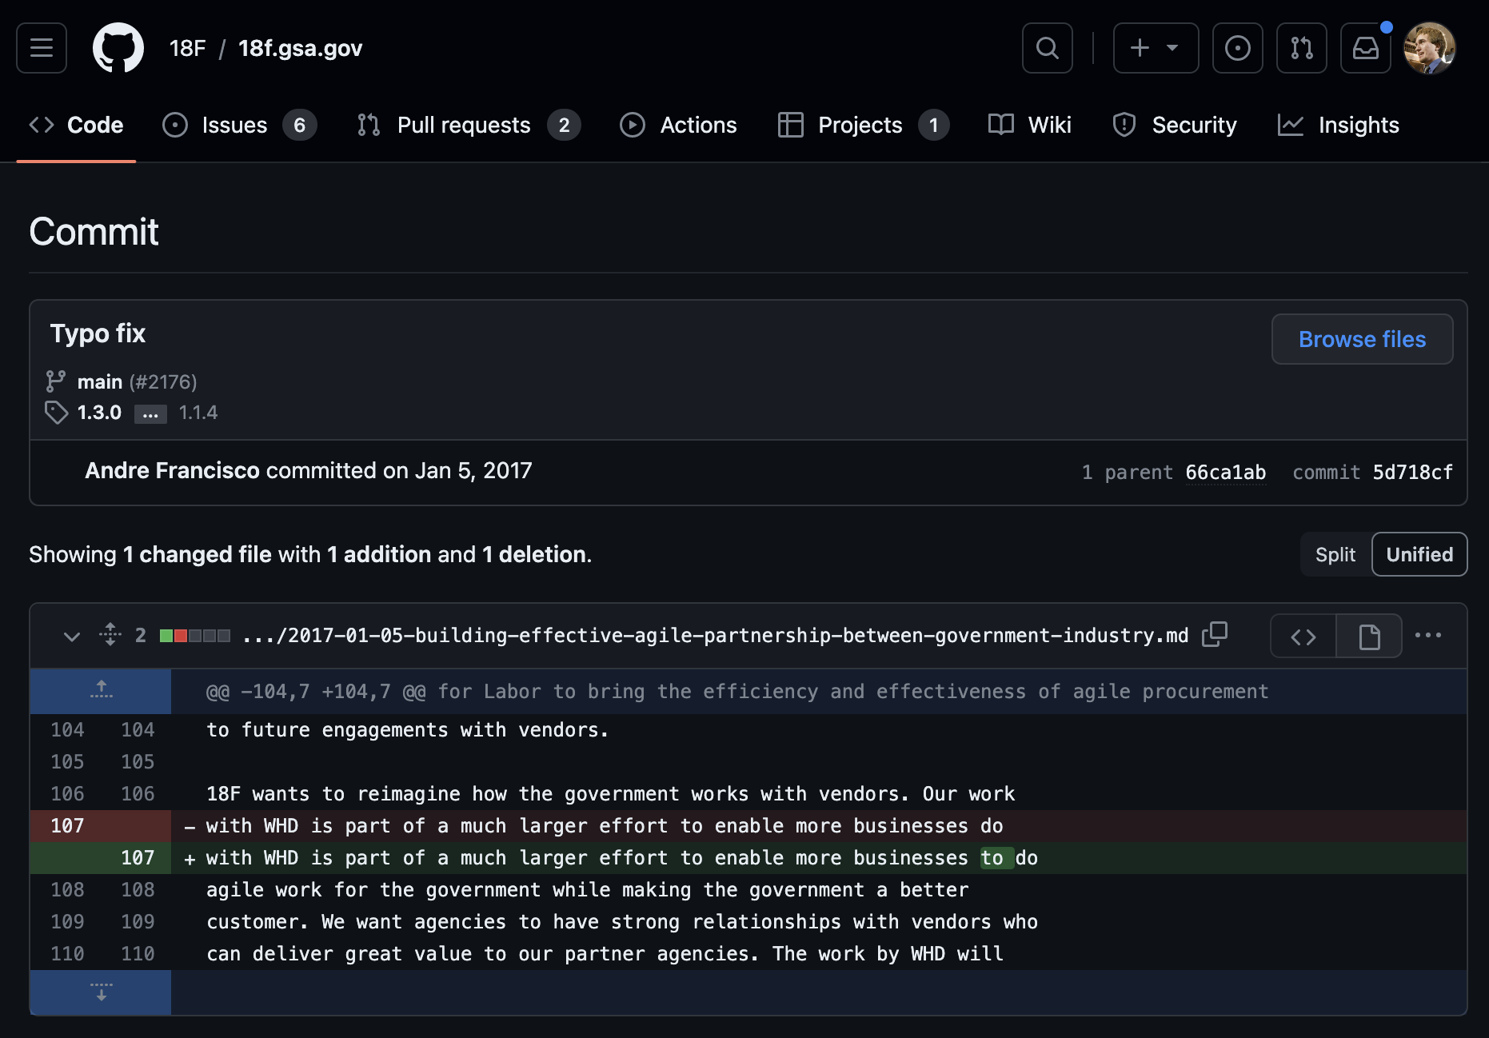
Screenshot slide, dark color theme

Slide 6
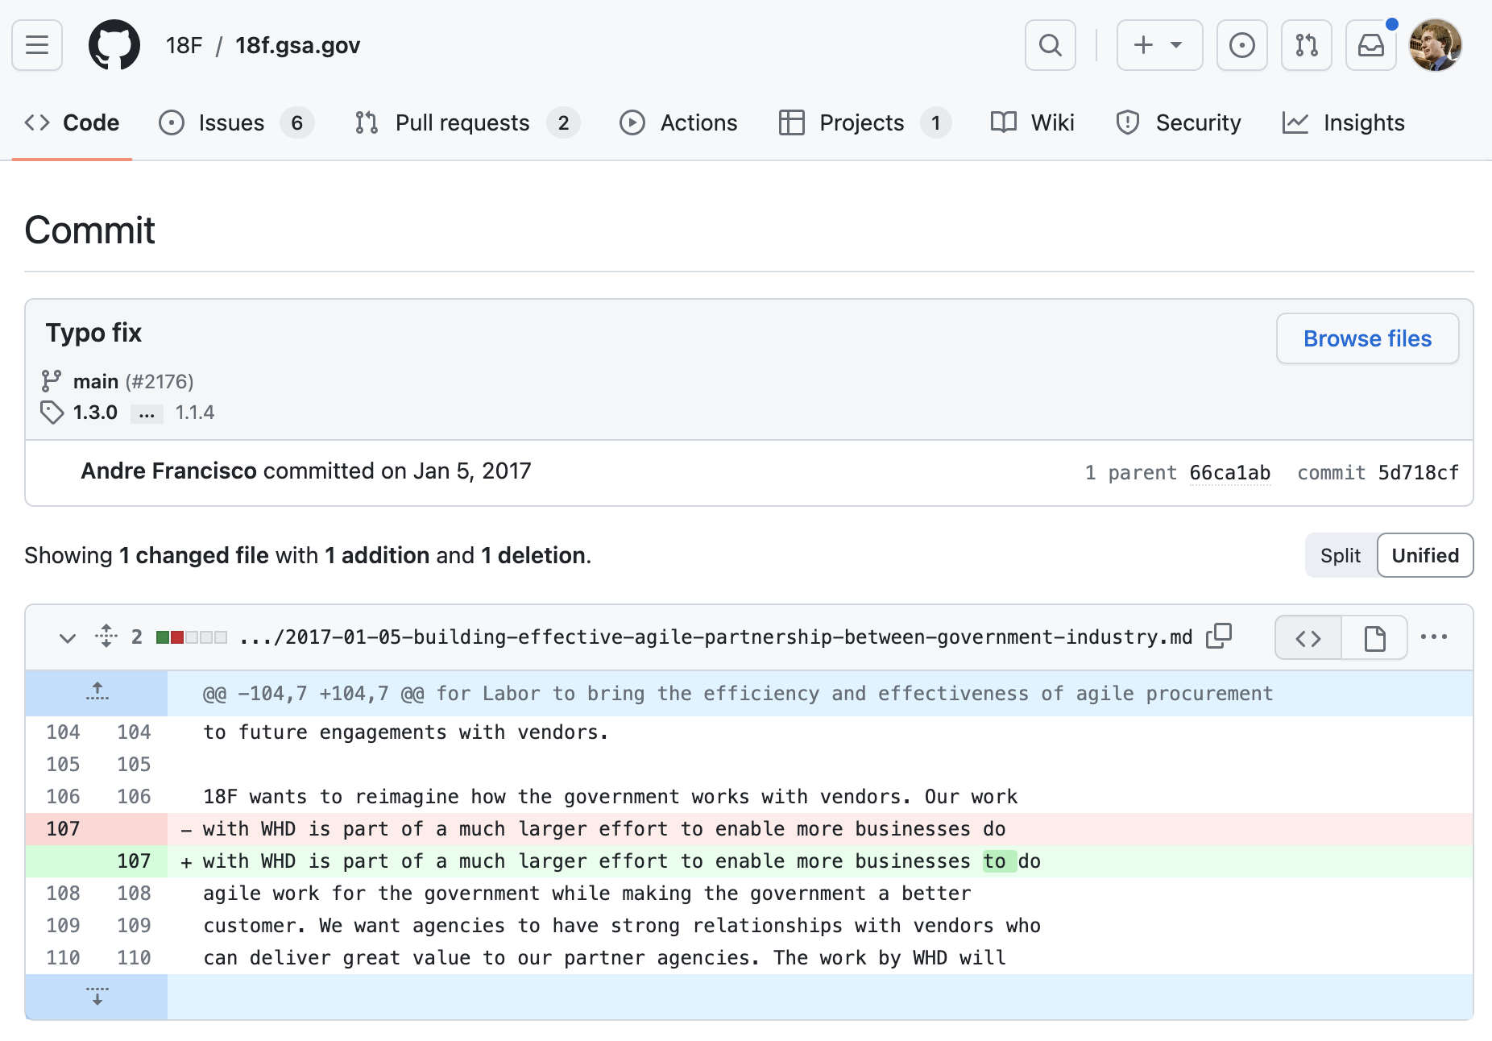
Screenshot slide, light color theme

Slide 7
Orgs
Orgs "own" various GitHub projects under version control. Examples: https://github.com/GSA, https://github.com/EOP-OMB
--
Your personal projects live under your GitHub account, such as https://github.com/wslack

Slide 8
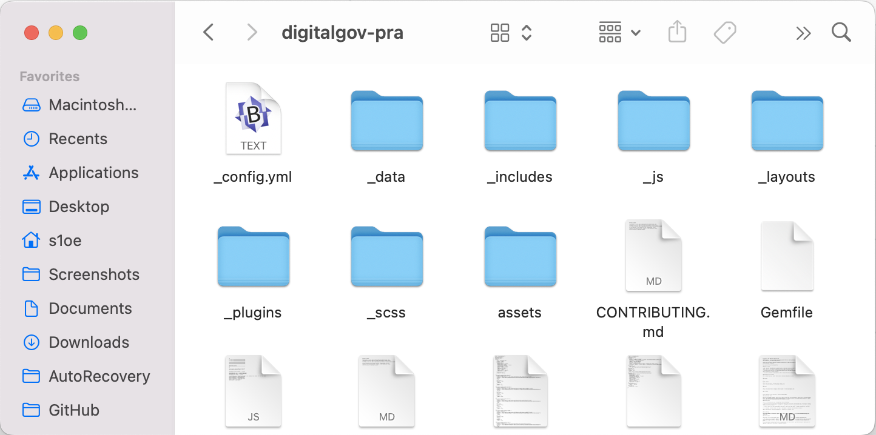
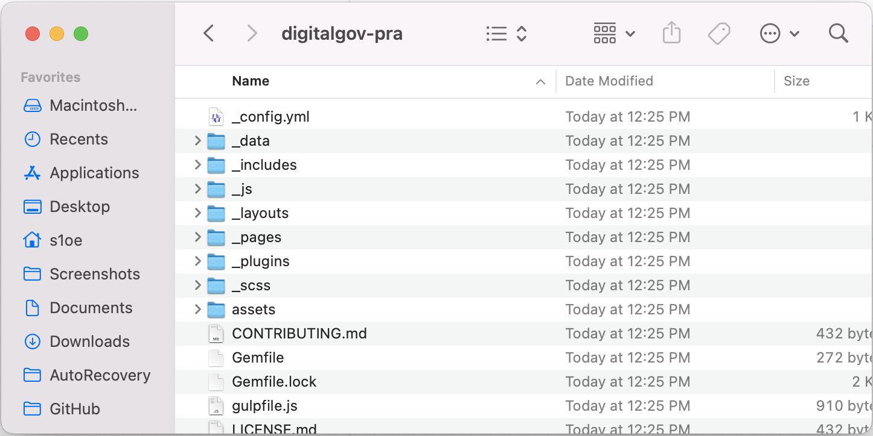
Repository (or Repo)
A repo is a folder with version control on its files that you view on GitHub. Repos sit under an org or personal account.
Compare https://github.com/GSA/digitalgov-pra with the below images.

Slide 9
Commit
A commit is like saving a new version, but smarter.
Git remembers not only the status of everything in the repo, but also each of the specific changes in the “history” of each file.
Let’s go back to that typo fix: https://github.com/18F/18f.gsa.gov/commit/5d718cfdcaab861ad584c685667120ffd50178f5

Slide 10
Branch
Branches are like sandboxes in the repo for other people working on the project to prepare contributions without affecting the live project.
A branch is like building another copy of a house on the same property to test out what happens if you change the furniture in a room.
The main project branch is usually called "main." It's also typical to have a "staging" branch to test out changes that are about to go live.

Slide 11
Fork
Forks are like branches, but they "live" on someone else's property, with their own branches.
You can fork a public GitHub repo if you want to change things about it in your own space.

Slide 12
Pull Request
You have a separate branch or fork with your change.
You are *requesting* that commits from one place be *pulled* into the main branch.
When that happens, it is called a *merge*.
You can continue to make edits in the branch until the pull request is merged.
This is an easy way to track someone else’s review of your updates.
Example: https://github.com/18F/18f.gsa.gov/pull/3712

Slide 13
Issues
Conversations on GitHub, associated with a repo
Used by team members or the public to file ideas or comments.
Example issue: https://github.com/18F/18f.gsa.gov/issues/3666
Example issues page: https://github.com/18F/hourofcode/issues

Slide 14
Markdown
Markdown is designed so that text can be easily converted to HTML. You can use the “preview” button on GitHub to see if your markdown will appear the way you expect.
GitHub displays markdown for “.md” files
Issue screens have markdown helper tools
https://en.wikipedia.org/wiki/Markdown#Examples

Slide 15
Projects
Allows you to use GitHub for project management, either within a repo or across all repos in an org:
https://github.com/GSA/digitalgov.gov/projects?type=classic
https://github.com/orgs/GSA/projects

Slide 16
Wiki
A repo on GitHub may have a wiki for documentation.
Documentation is also in the README files in the main repos – norms may vary in different places
https://github.com/GSA/data.gov/wiki
https://github.com/GSA/data.gov#readme

Slide 17
Insights
Lets you see various facts/graphs about the repo
https://github.com/18F/18f.gsa.gov/graphs/contributors

Slide 18
Practice: creating an issue

Slide 19
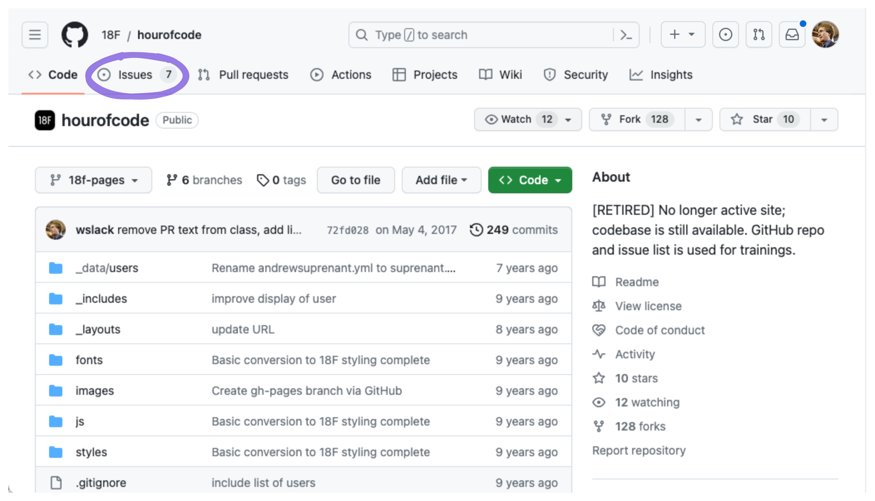
Workflow to create an issue, screenshot 1
Start on the main page of a repo, under “code”

Slide 20
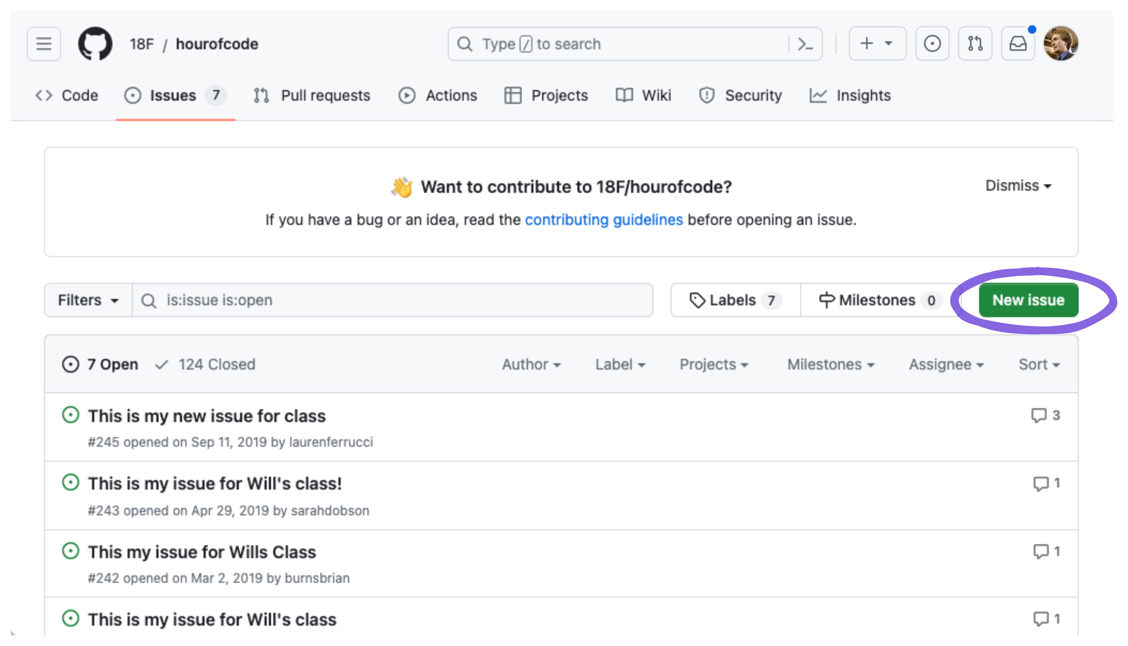
Workflow to create an issue, screenshot 2

Slide 21
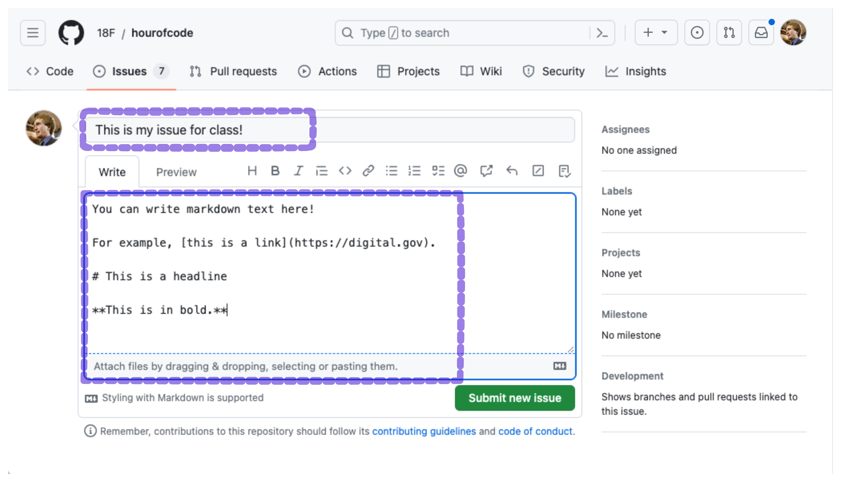
Workflow to create an issue, screenshot 3

Slide 22
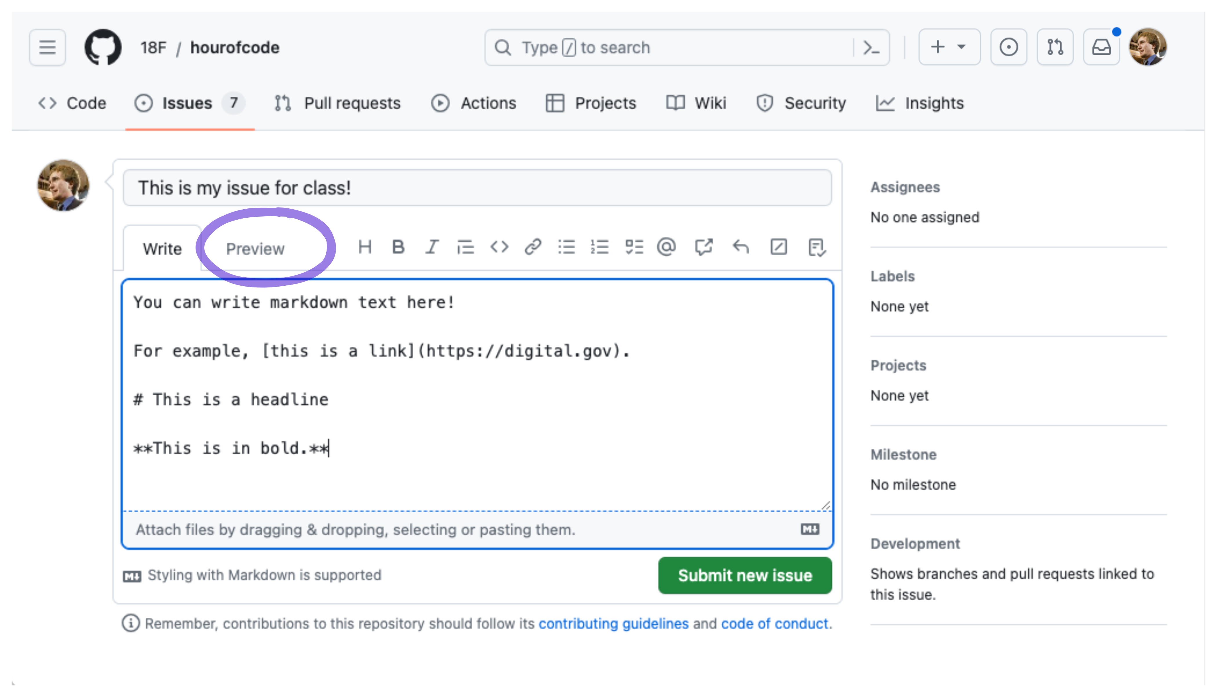
Workflow to create an issue, screenshot 4

Slide 23
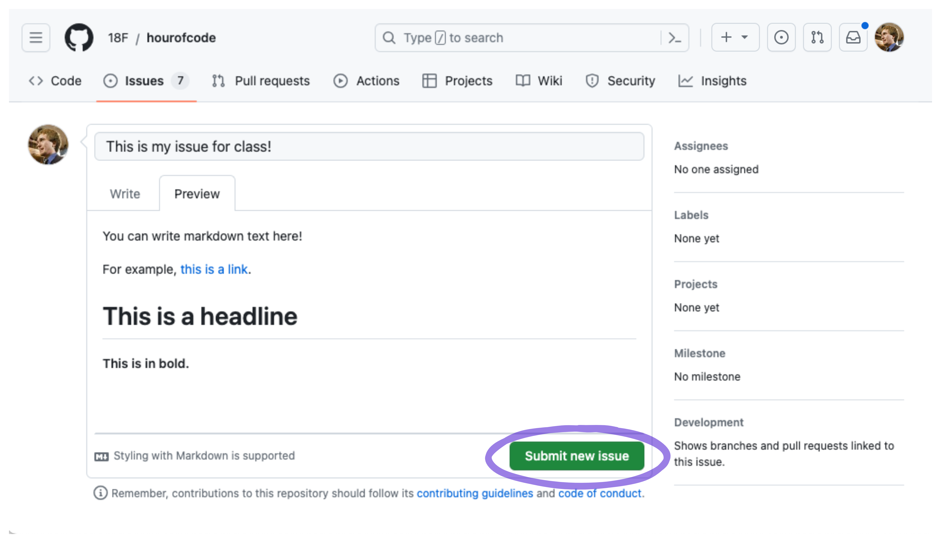
Workflow to create an issue, screenshot 5

Slide 24
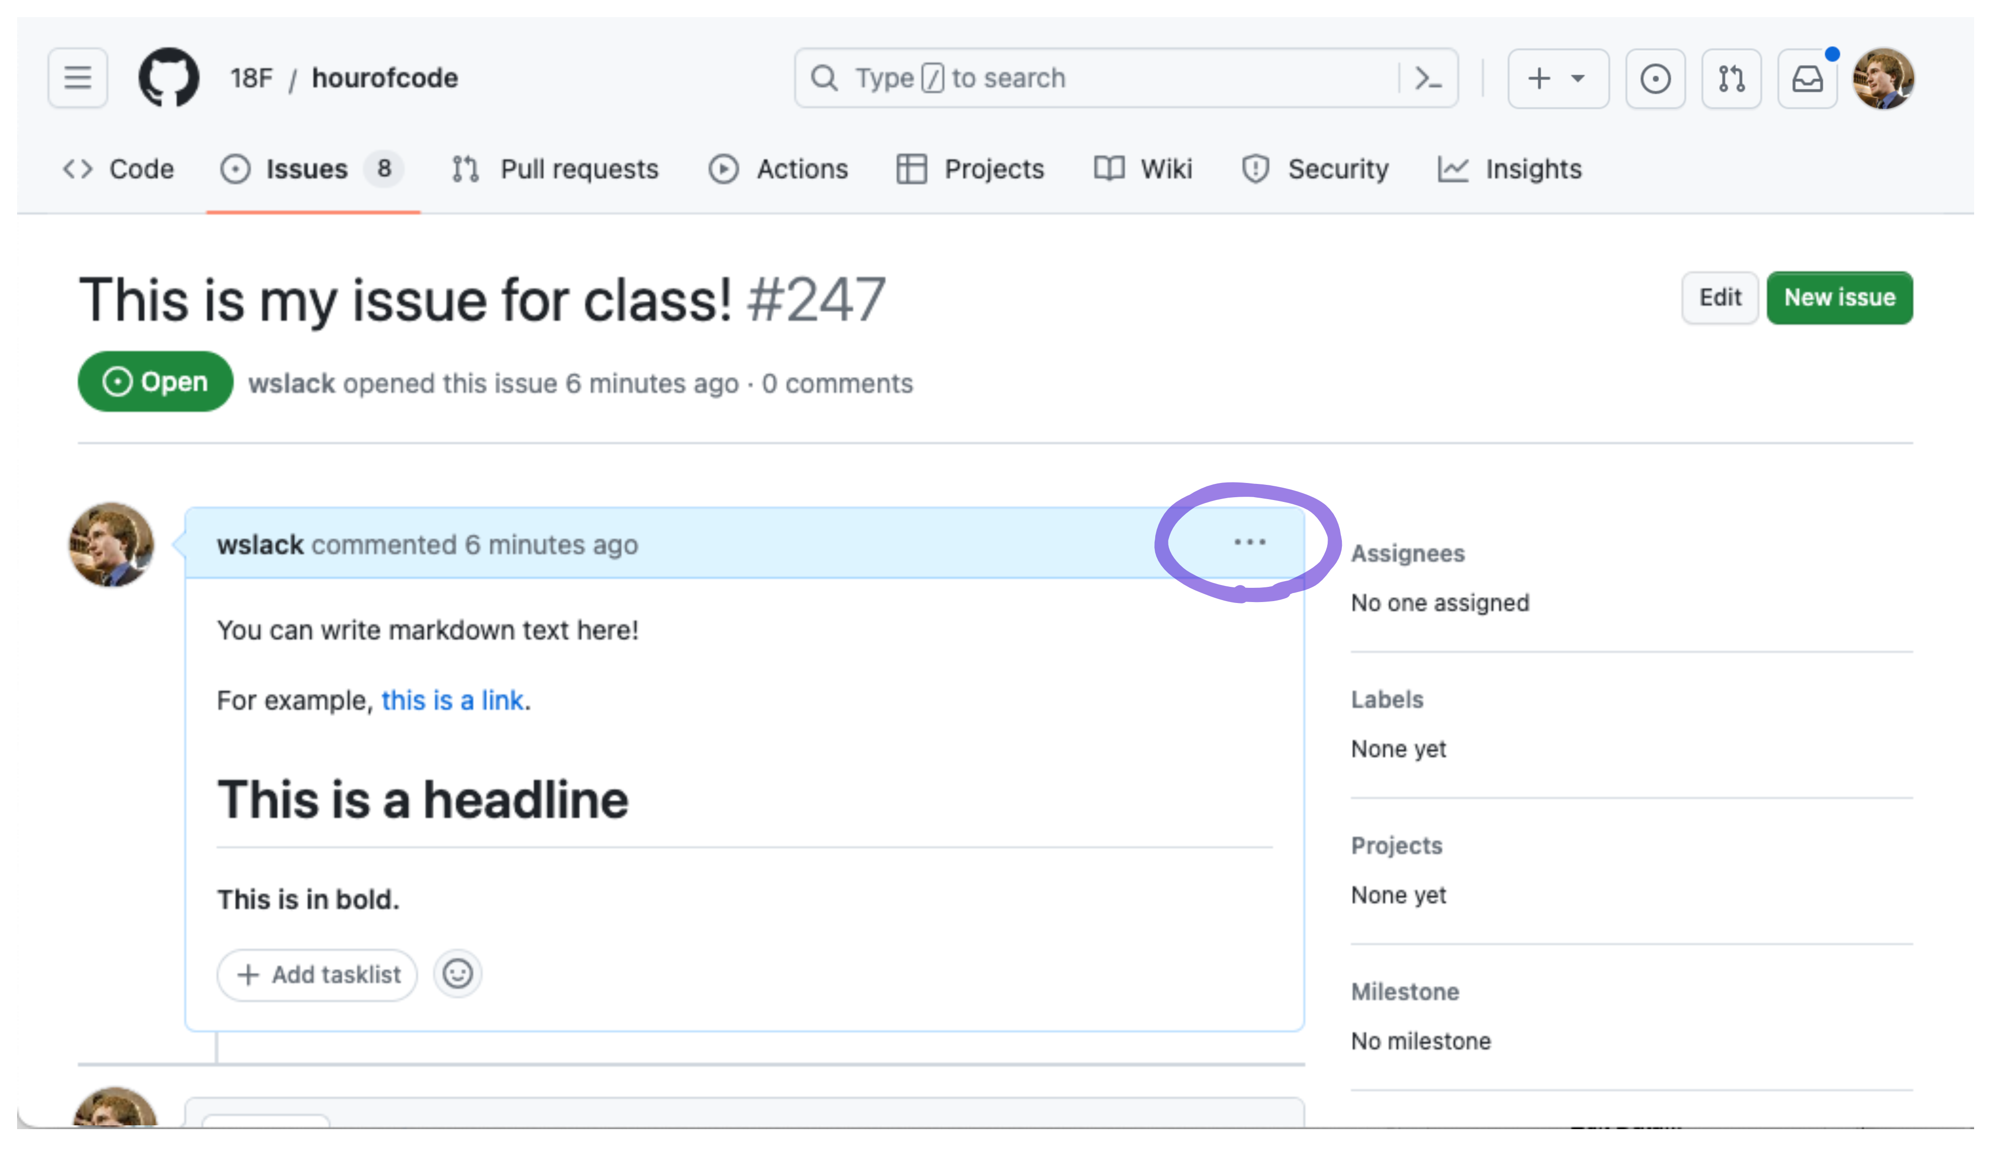
Workflow to create an issue, screenshot 6

Slide 25
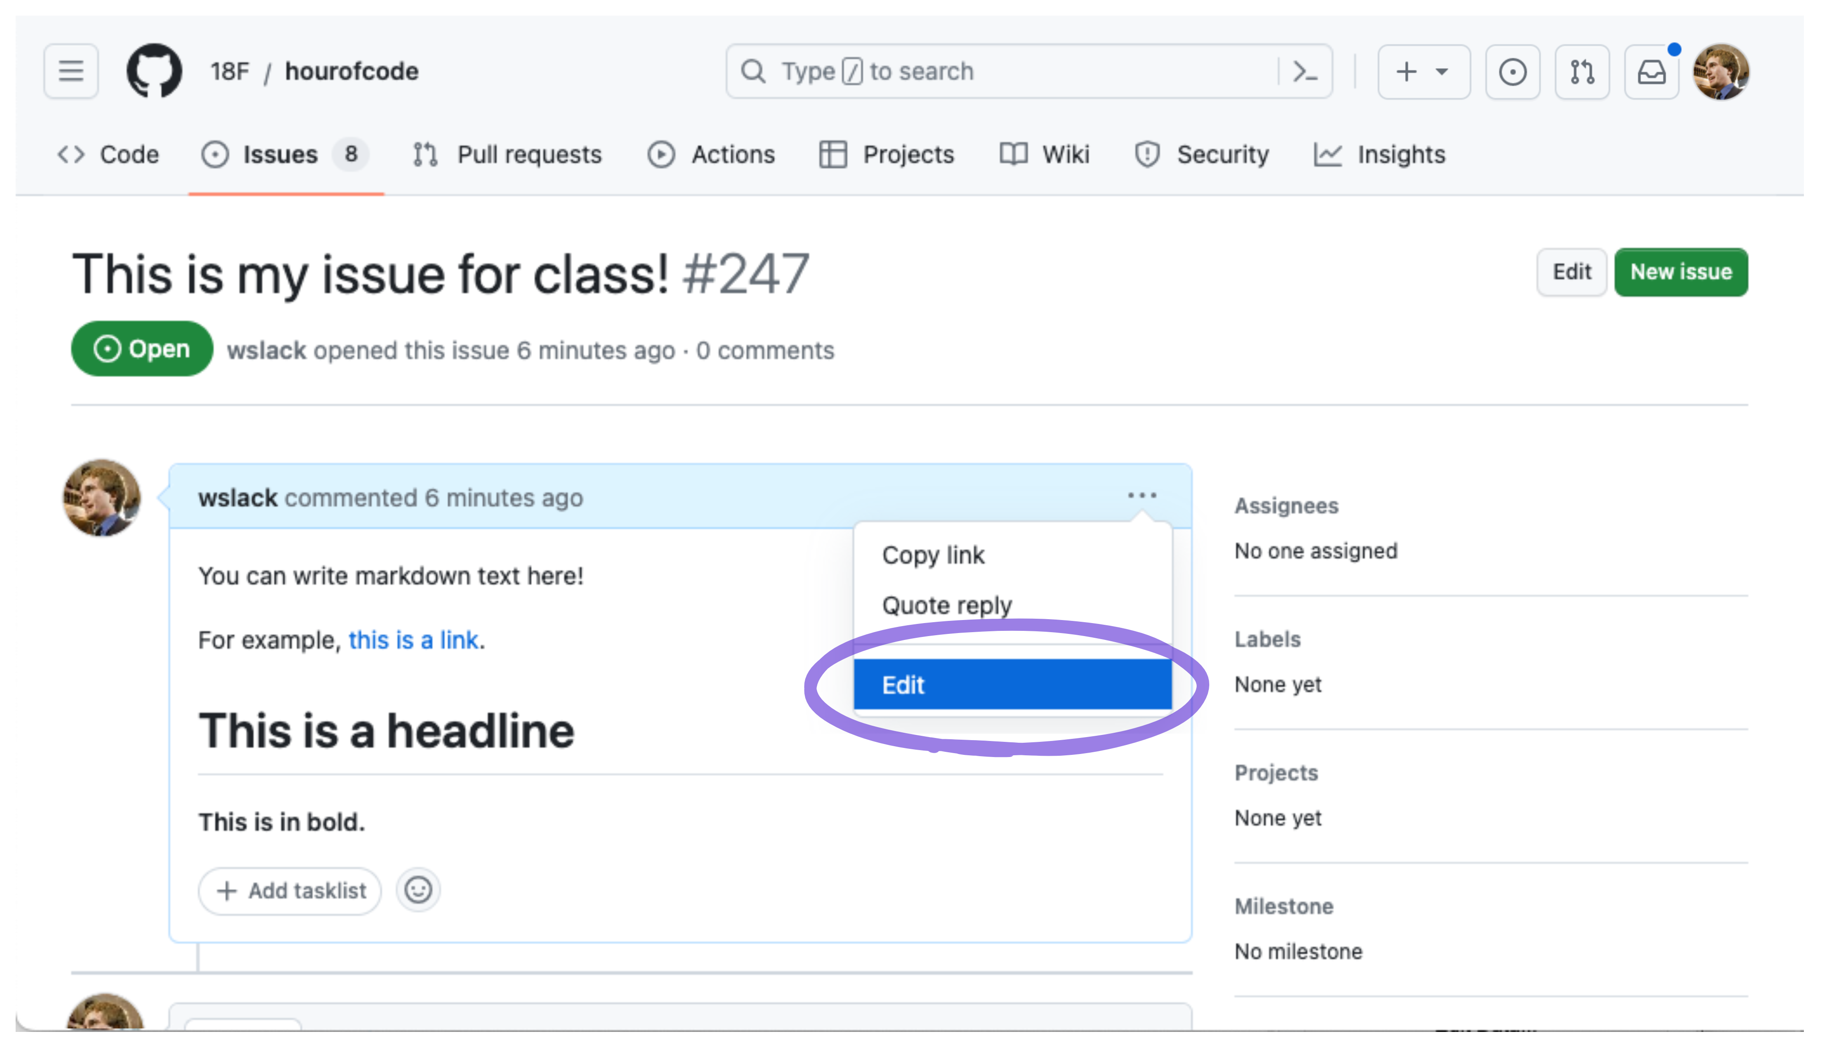
Workflow to create an issue, screenshot 7

Slide 26
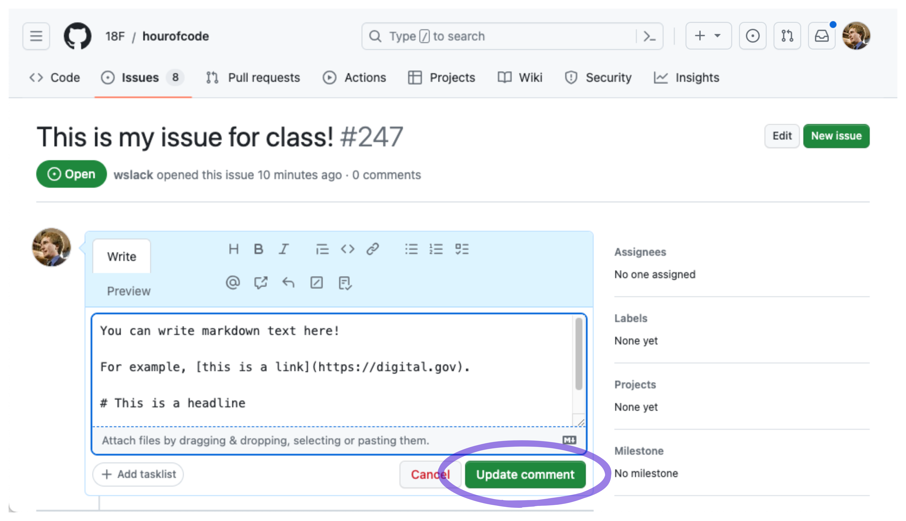
Workflow to create an issue, screenshot 8

Slide 27
Practice: creating a repo

Slide 28
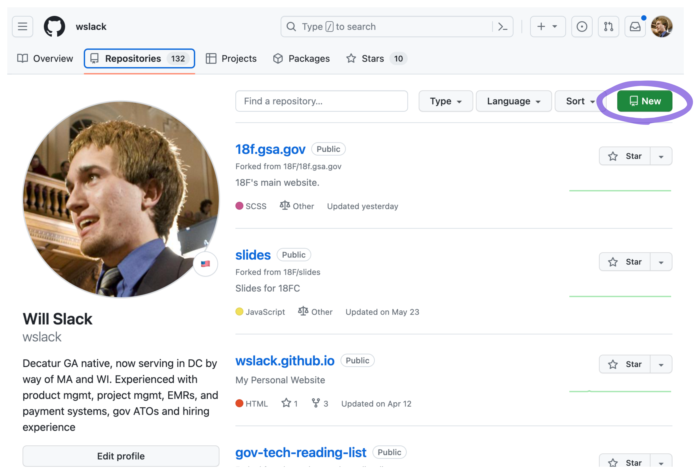
Workflow to create a new repo, screenshot 1
Or go to https://github.com/new

Slide 29
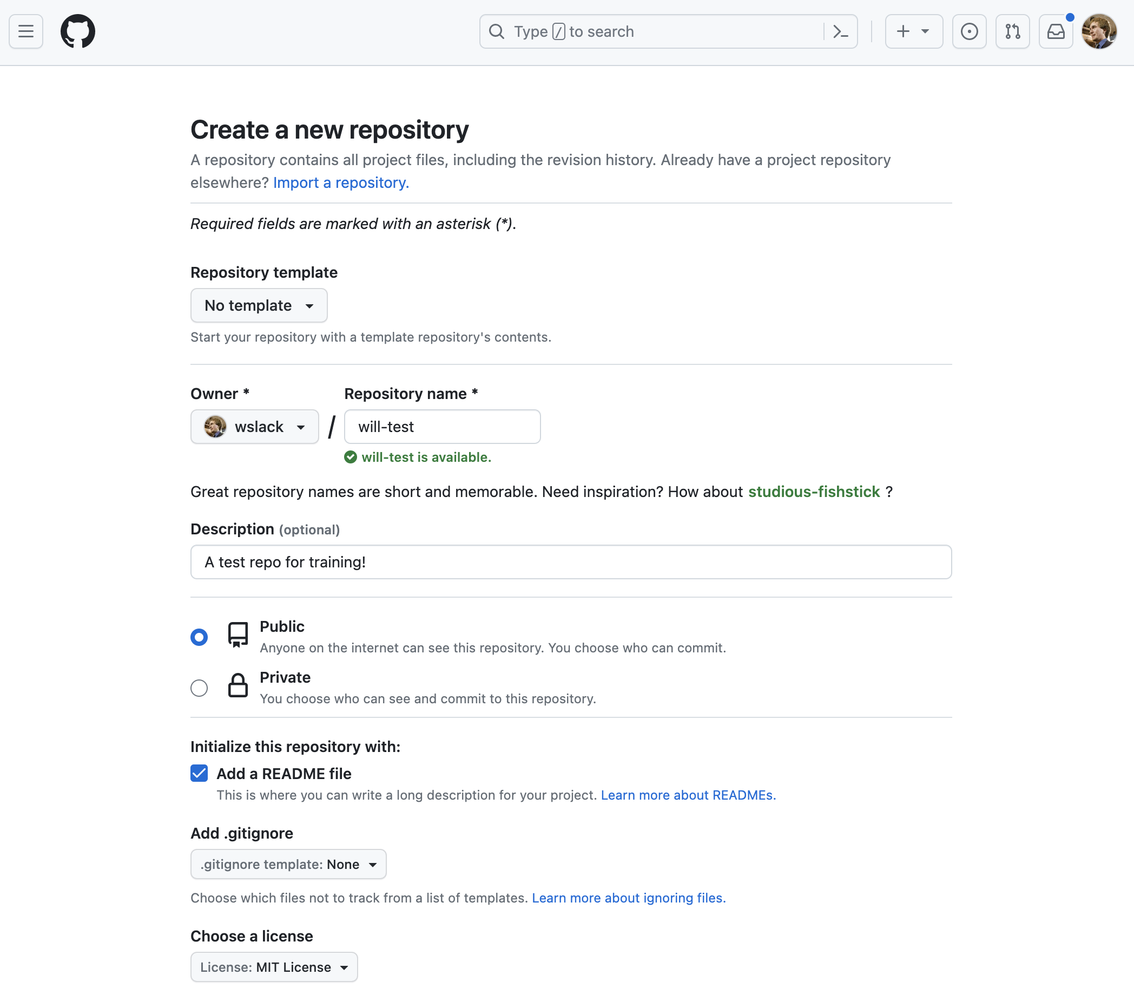
Workflow to create a new repo, screenshot 2

Slide 30
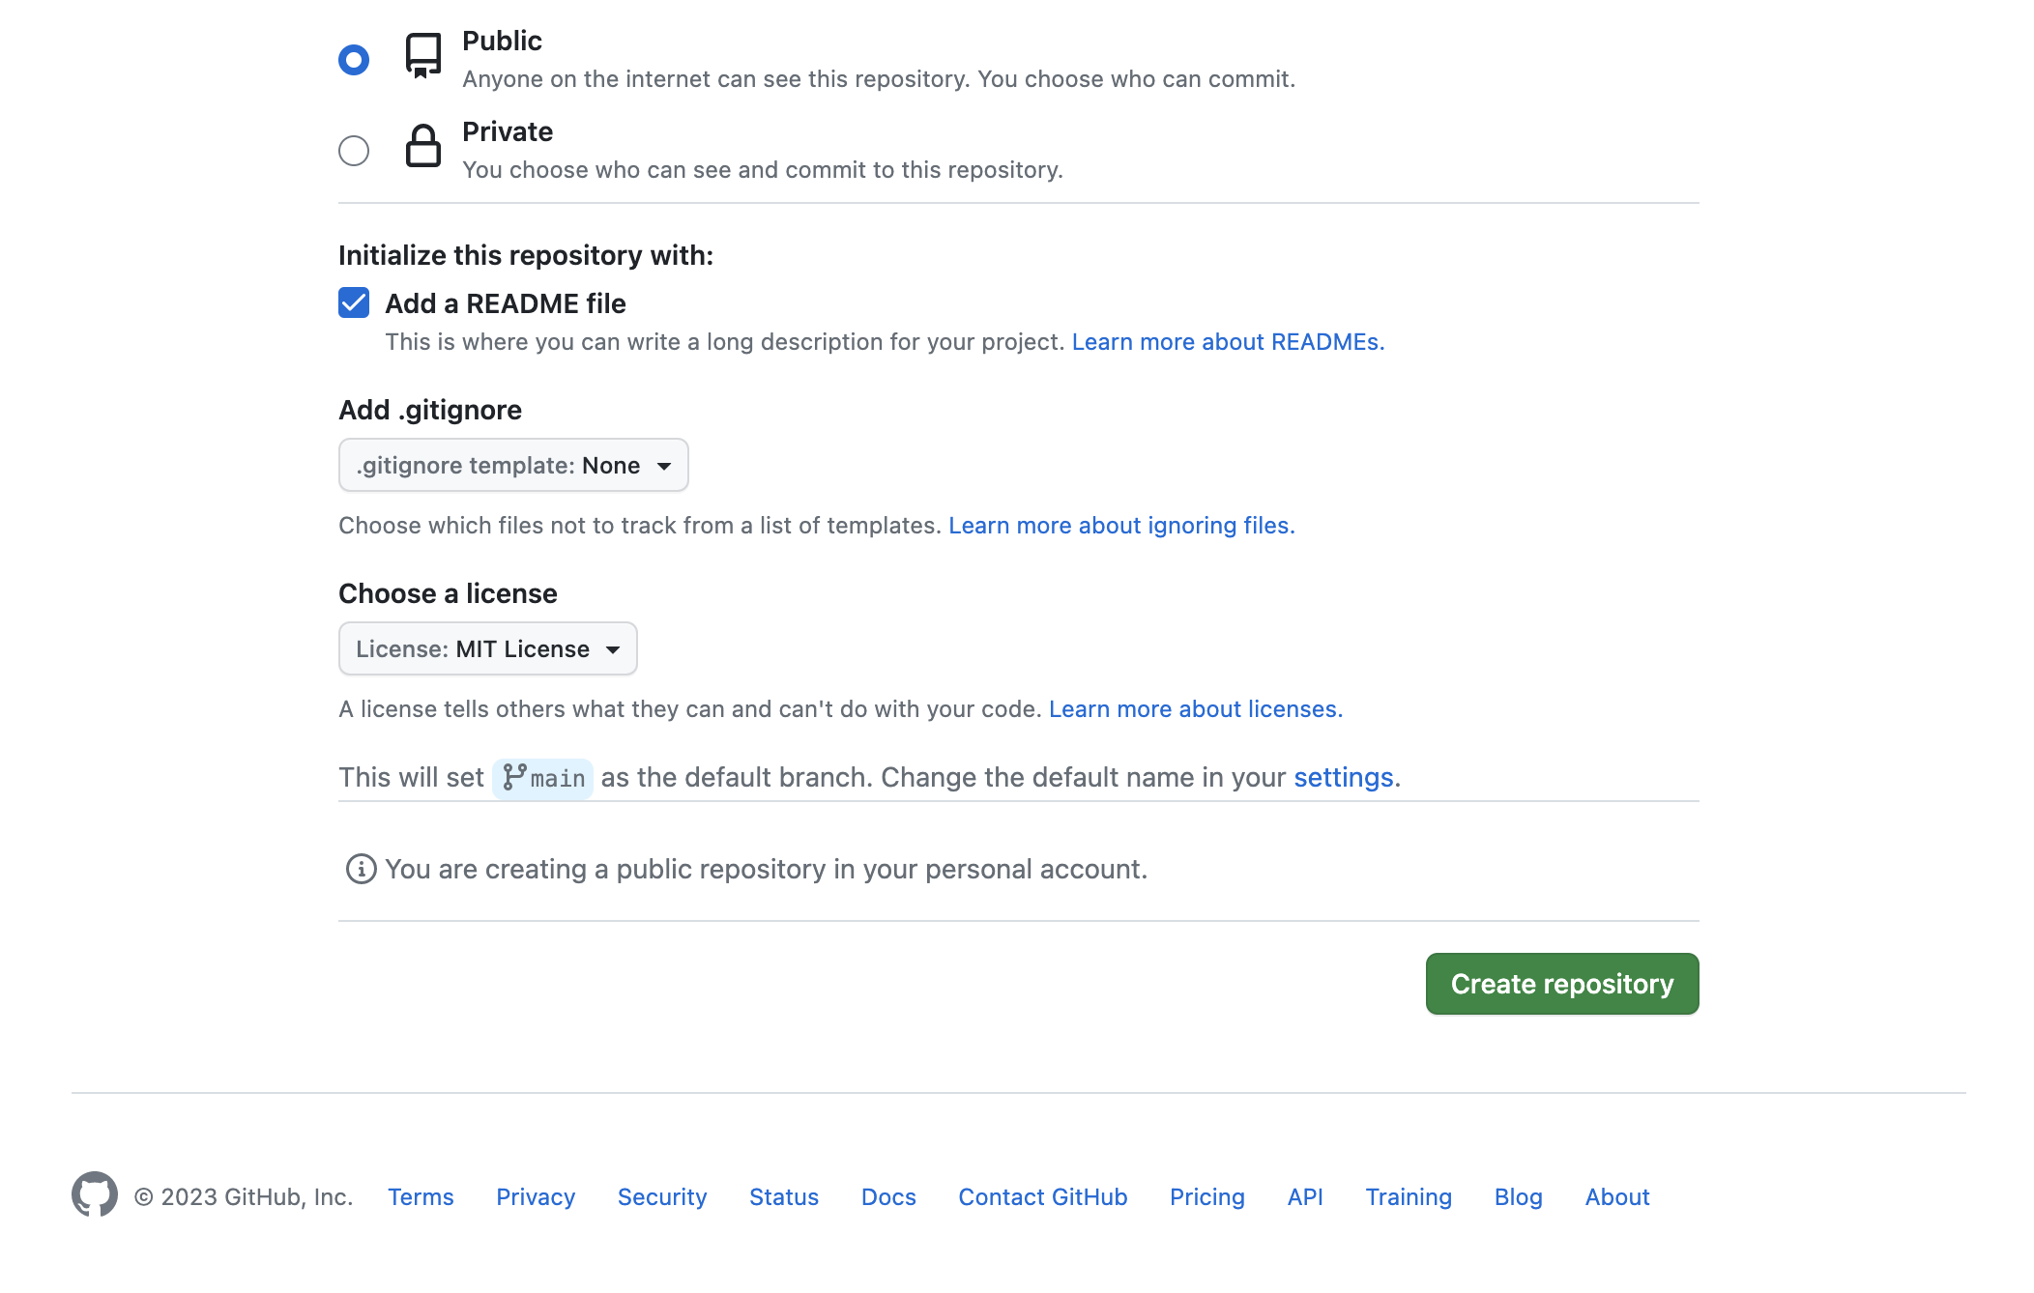
Workflow to create a new repo, screenshot 3

Slide 31
Practice: creating a pull request

Slide 32
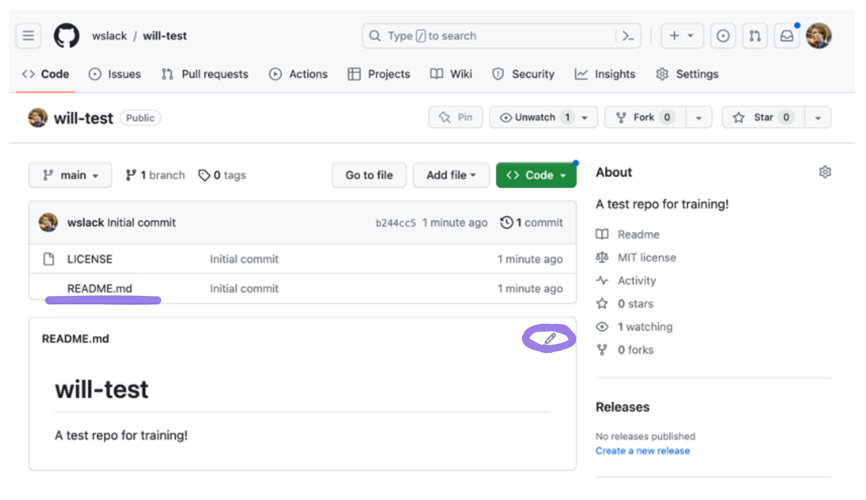
Creating a pull request screenshot 1
Start on the main page of a repo, under “code”

Slide 33
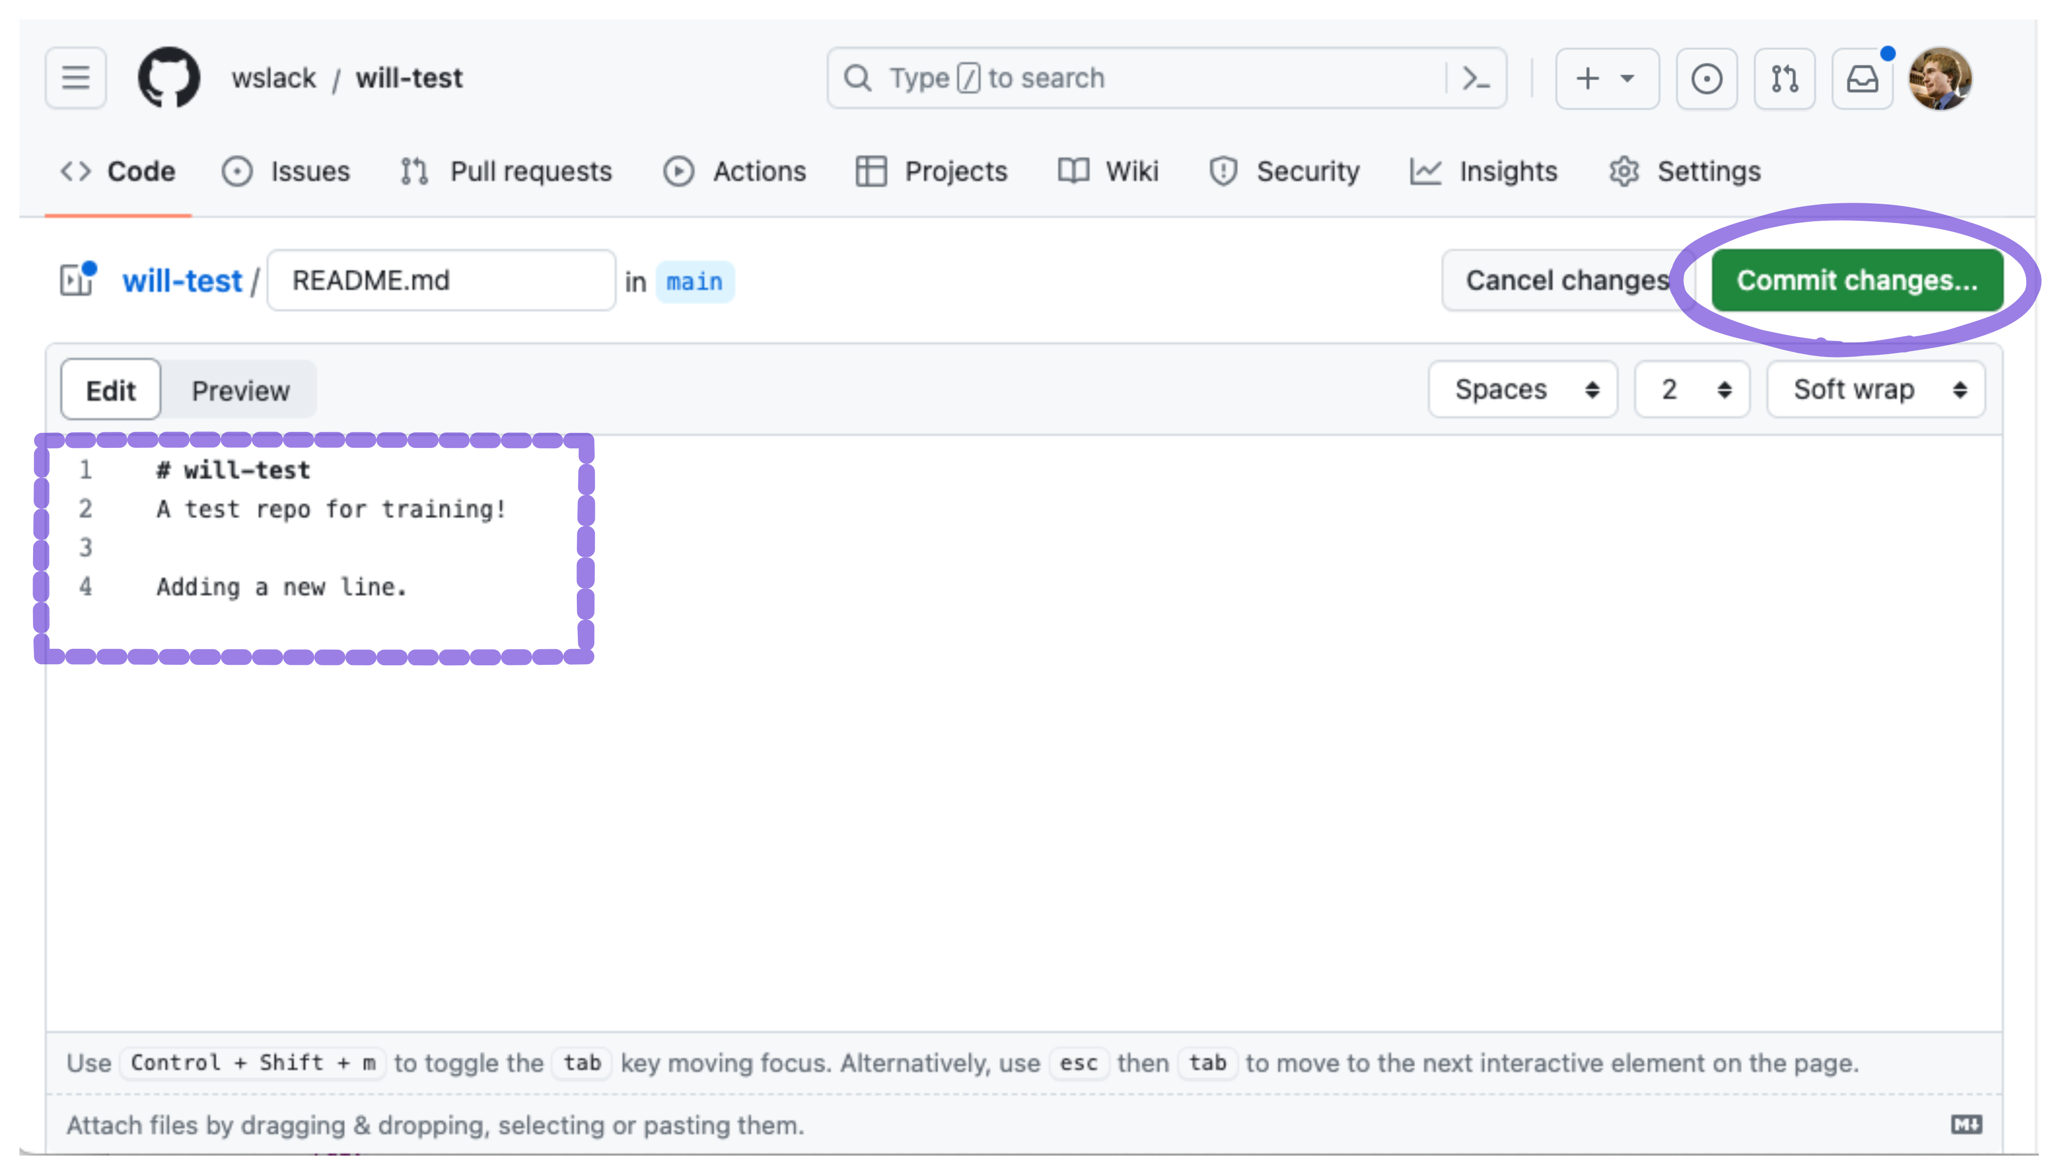
Creating a pull request, screenshot 2

Slide 34
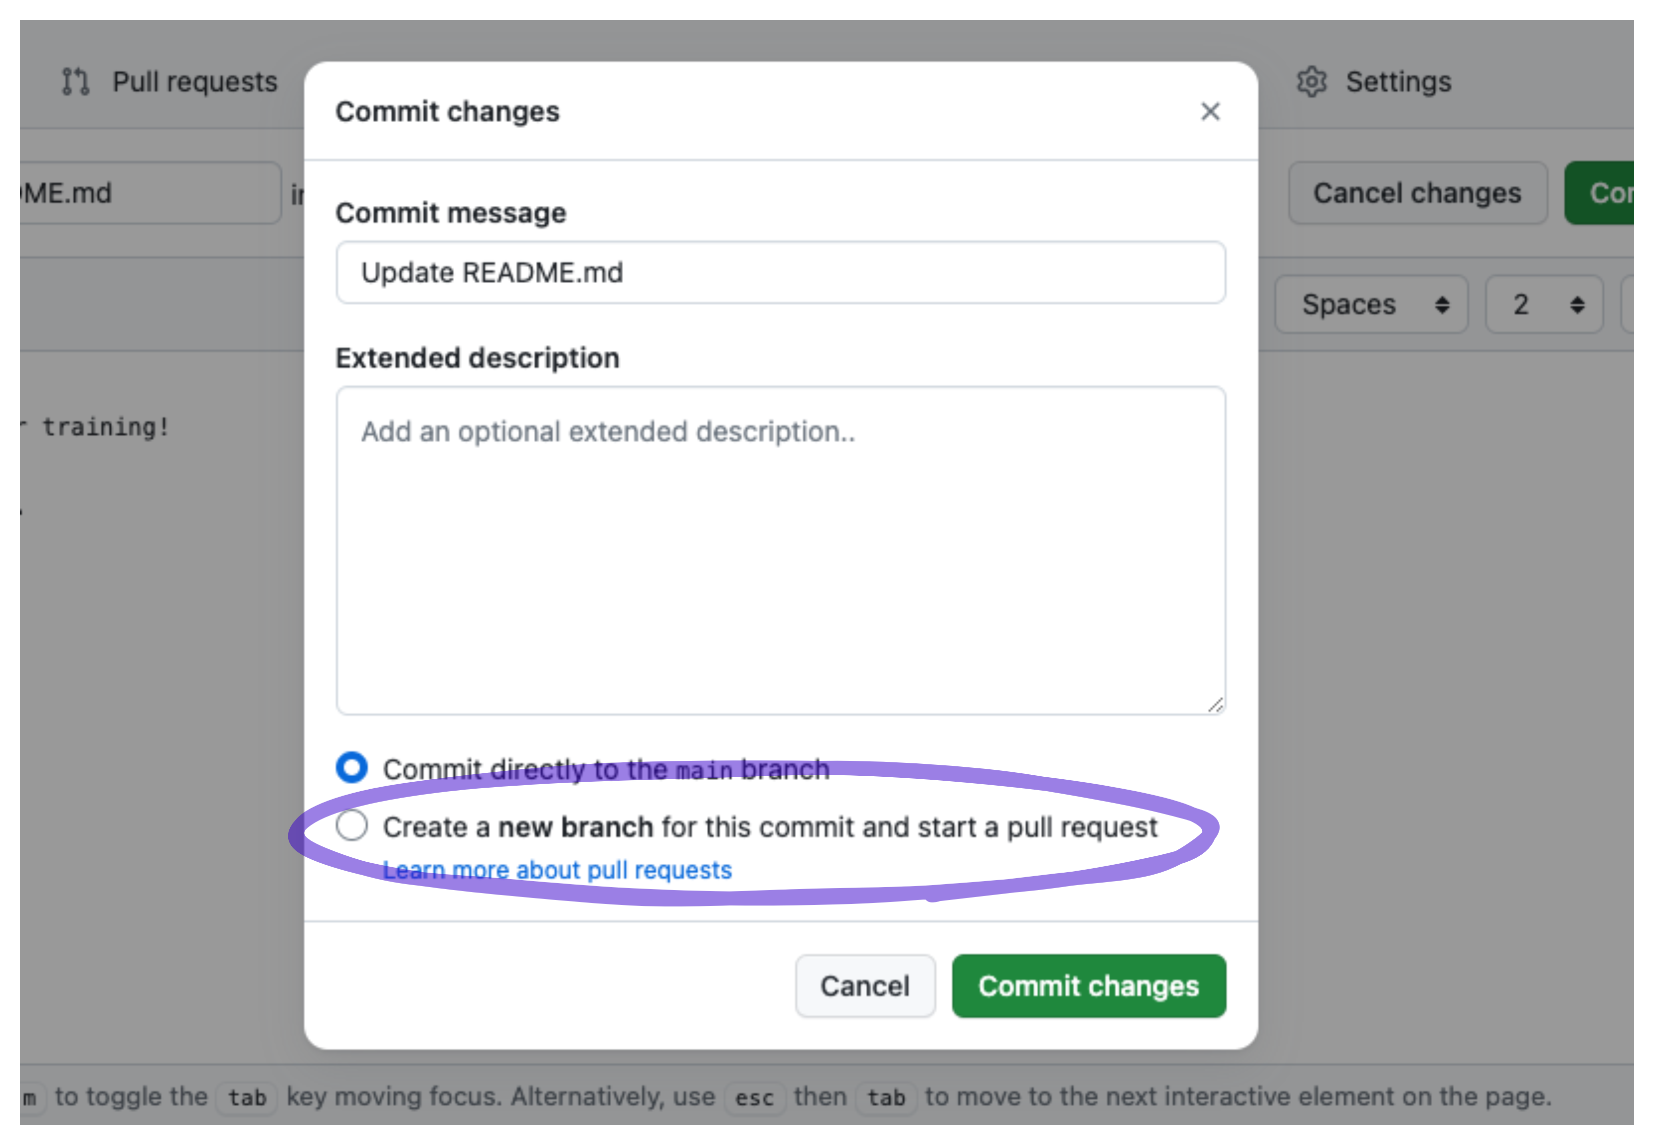
Creating a pull request, screenshot 4

Slide 35
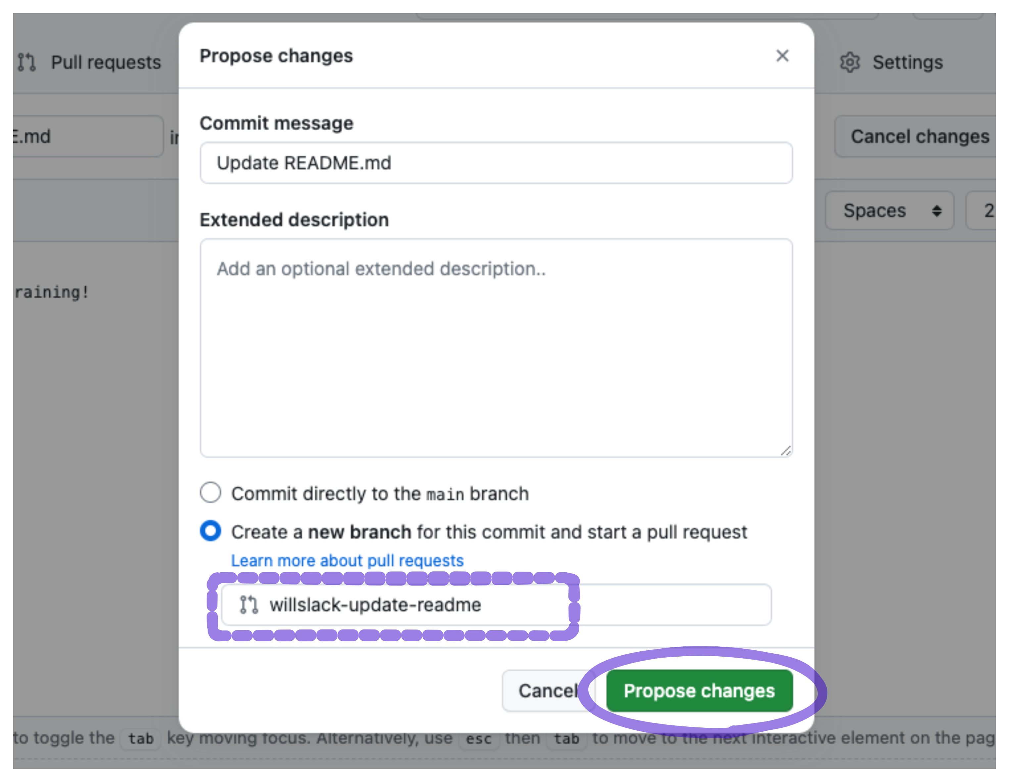
Creating a pull request, screenshot 5

Slide 36
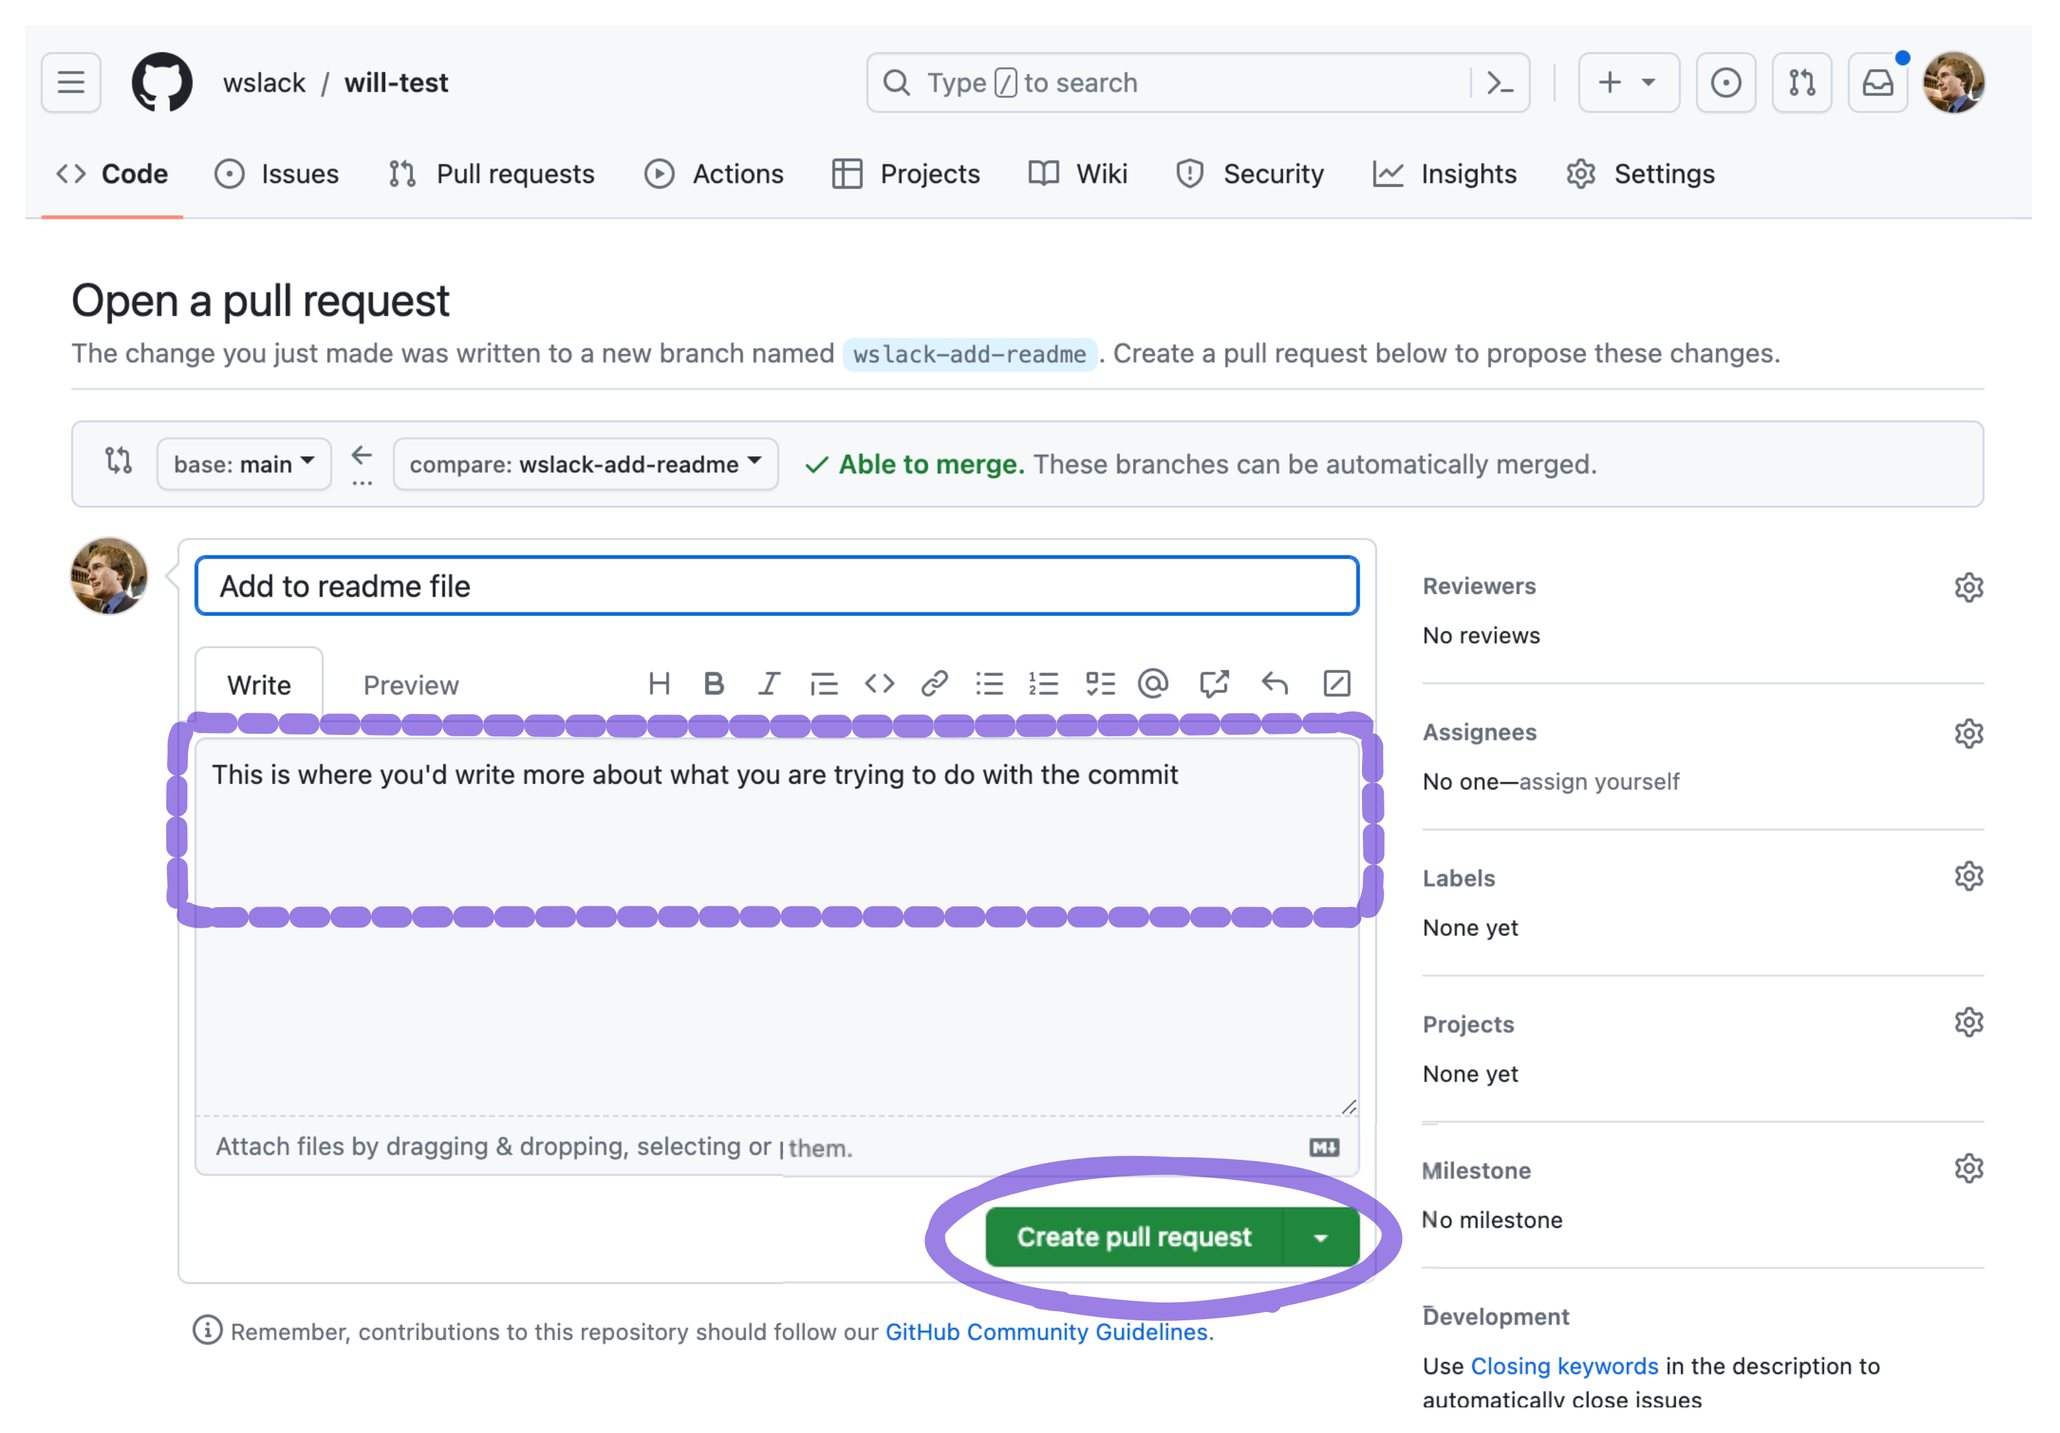
Creating a pull request, screenshot 6

Slide 37
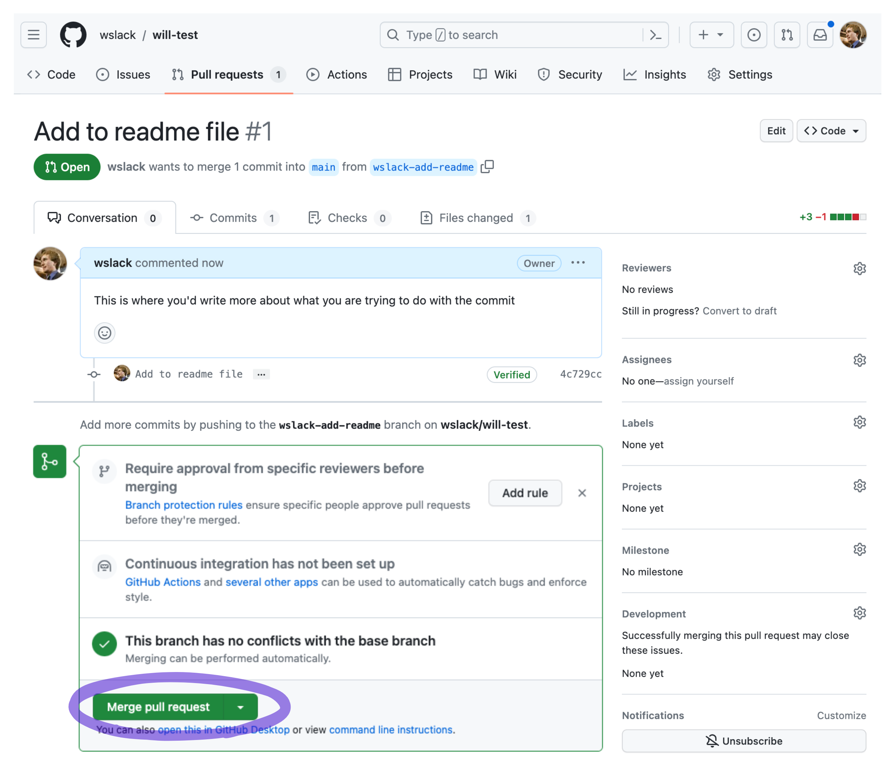
Creating a pull request, screenshot 7

Slide 38
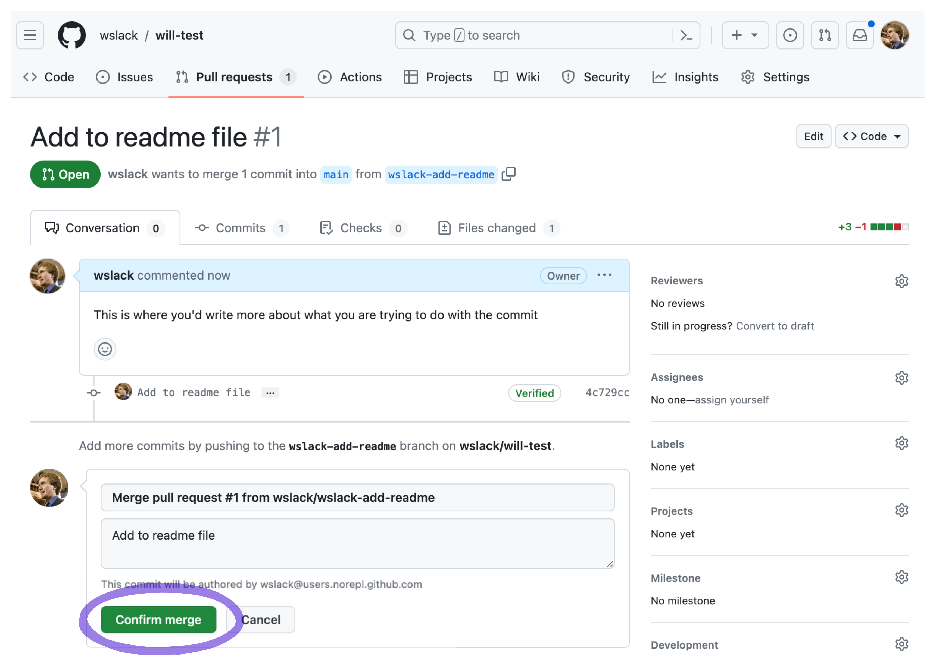
Creating a pull request, screenshot 8

Slide 39
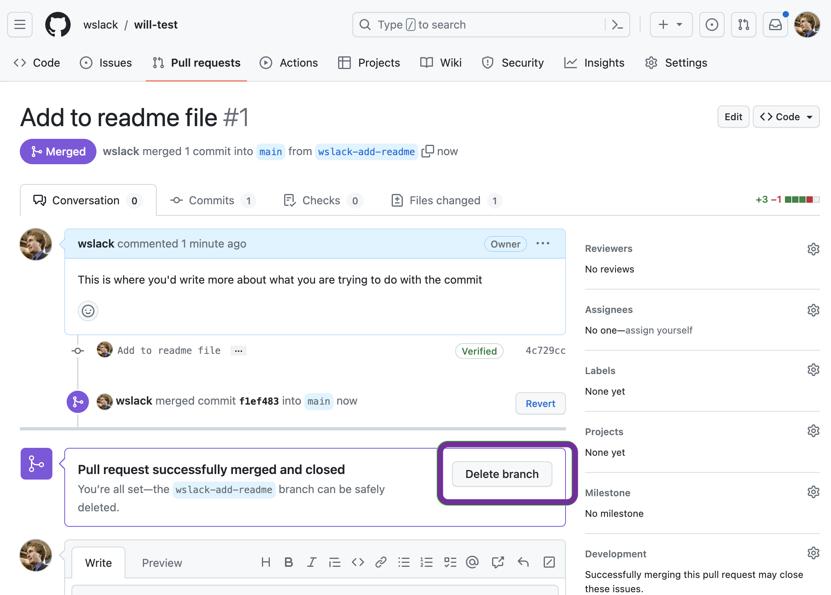
Creating a pull request, screenshot 9

Slide 40
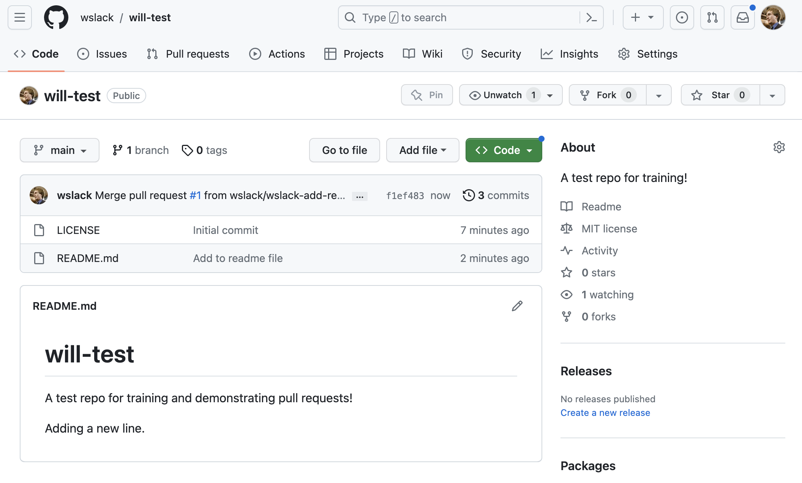
Creating a pull request, screenshot 10

Slide 41
Resources
An Introduction to GitHub – Digital.gov Training Page
https://digital.gov/resources/an-introduction-github/
TTS Handbook Intro to GitHub
https://handbook.tts.gsa.gov/training-and-development/intro-to-github/
Facts about publishing open source code in government
https://18f.gsa.gov/2016/08/08/facts-about-publishing-open-source-code-in-government/
Markdown help:
https://en.wikipedia.org/wiki/Markdown#Examples

